Slide 1
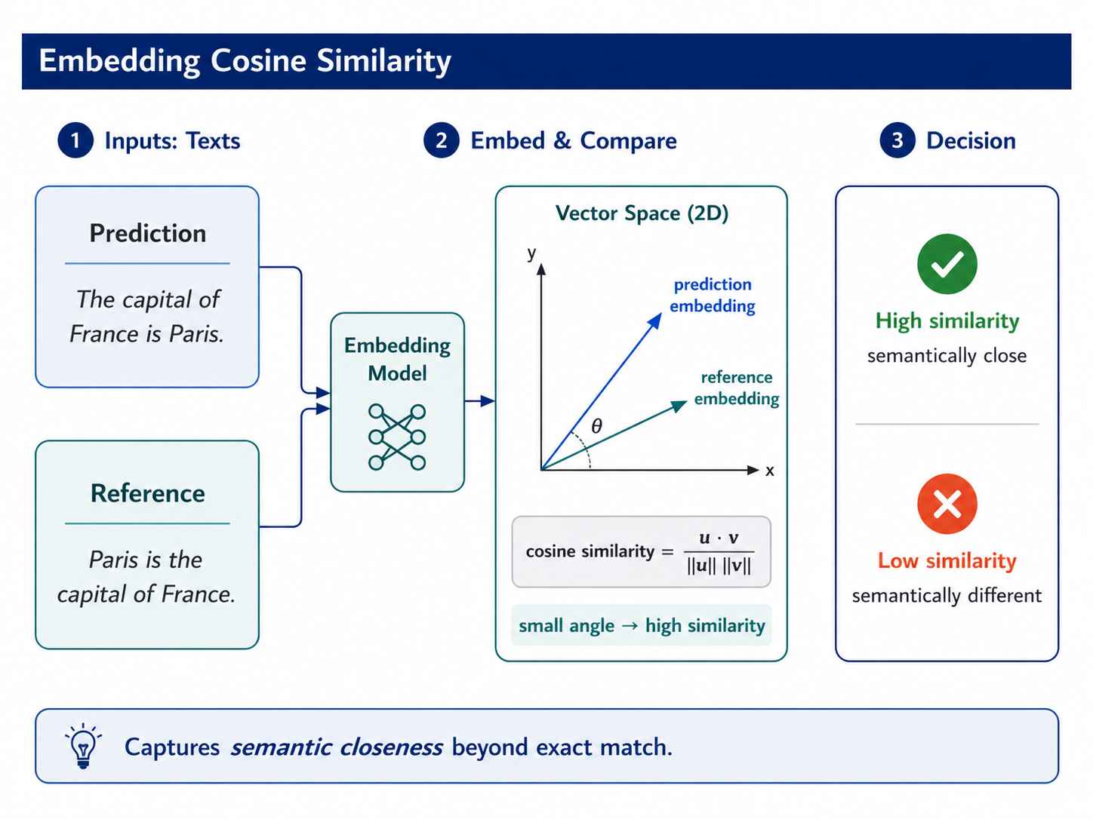
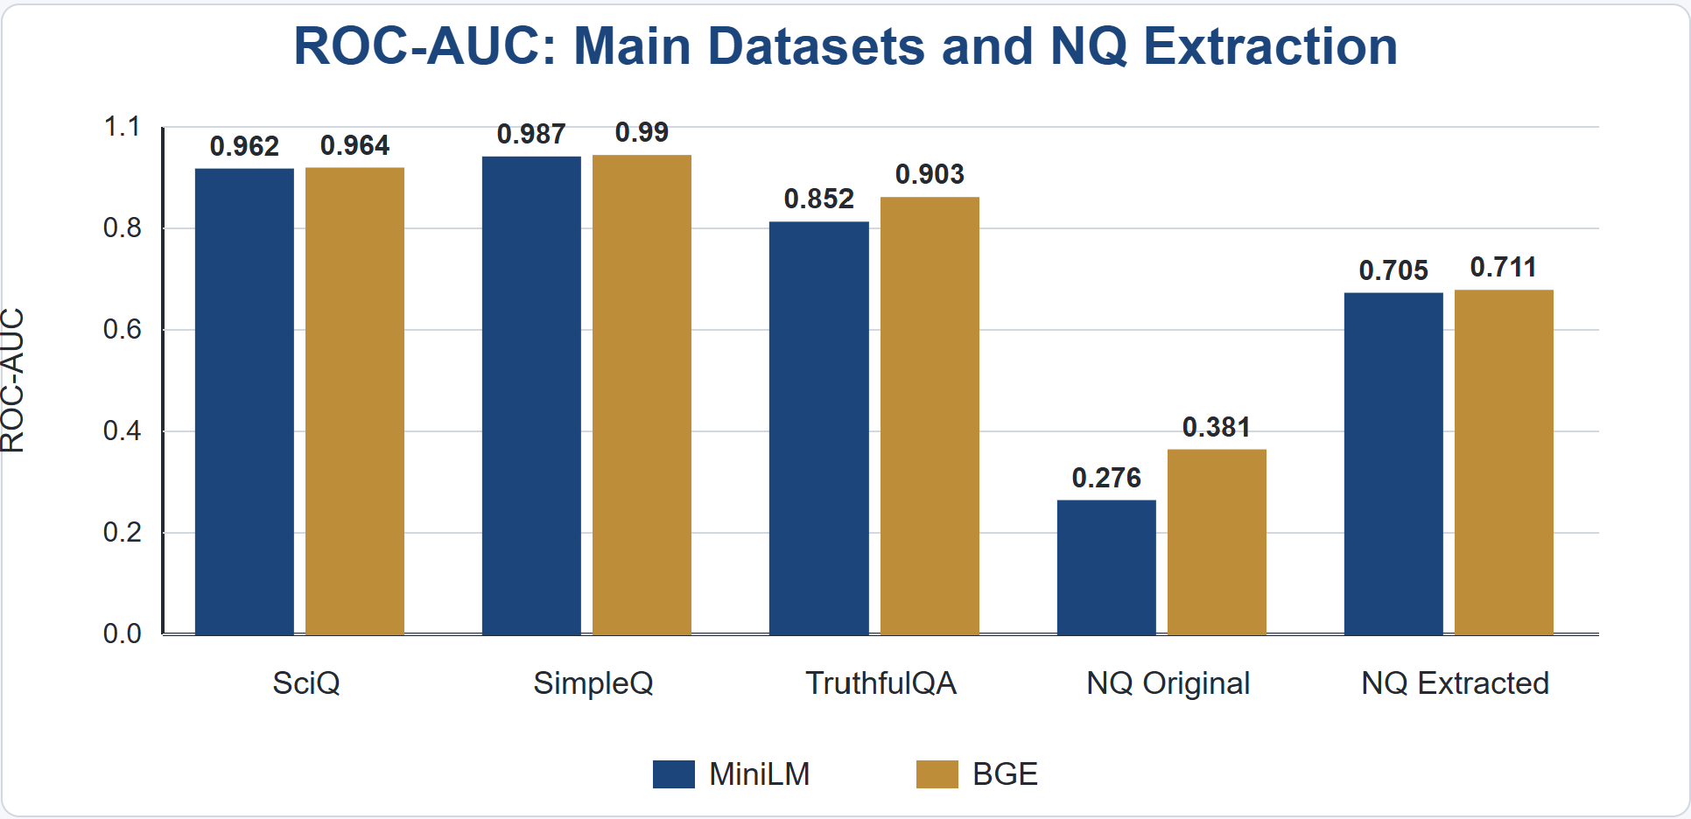
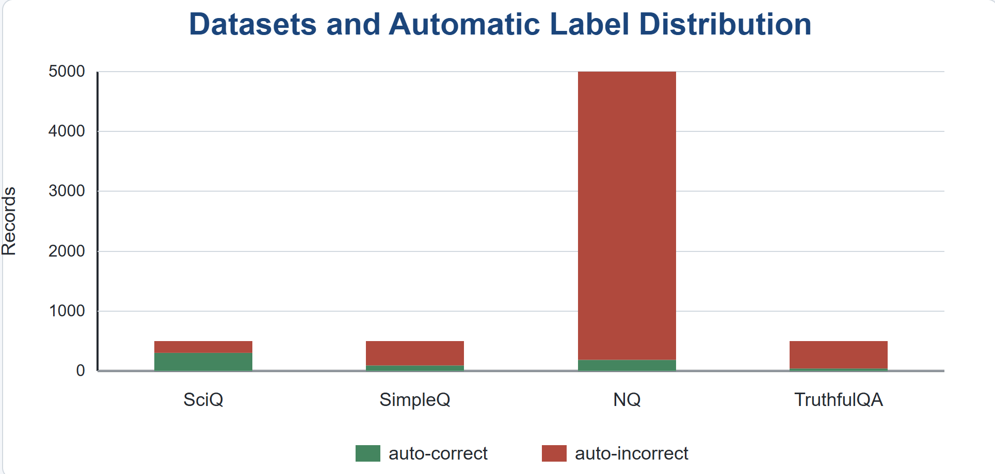
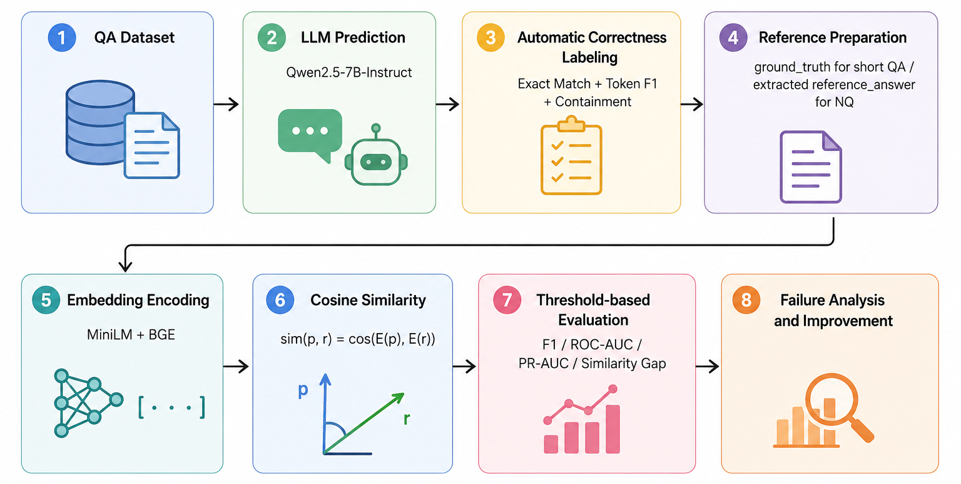
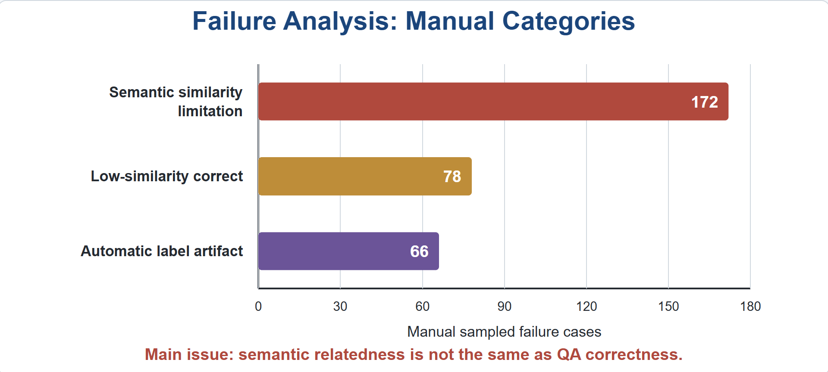
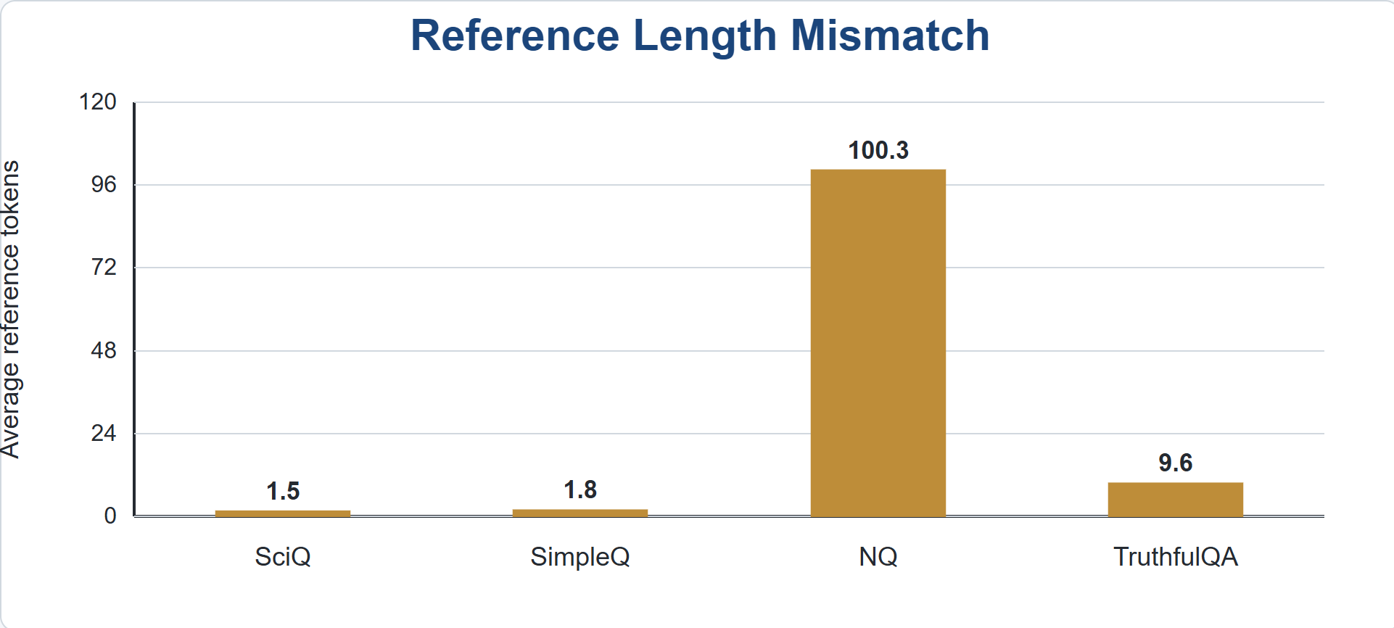
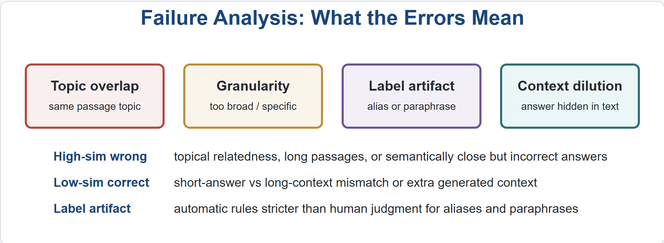
Semantic Similarity in Latent Space for LLM Prediction Evaluation
Team Members: Che FENG, YanZhe XIE, Ye GUO
AIAA 4051 Final Research Project, Introduction to NLP, HKUST(GZ)
Problem Background
Experiment
Results
Advanced
LLMs can produce fluent QA answers, but judging correctness is difficult. Exact-match metrics miss valid paraphrases, while embedding similarity may capture meaning better. However, semantic similarity can confuse topic overlap with factual correctness, especially in long answers.
Research Question:
Can cosine similarity between prediction and reference embeddings distinguish correct from incorrect LLM-generated QA answers?
Experiment
We evaluate the similarity-based correctness signal on both short-form and long-form QA datasets. The main experimental variable is reference granularity: short-form datasets usually provide compact answer spans, while NQ originally provides long Wikipedia evidence passages.
Dataset | Type | MiniLM ROC-AUC | BGE ROC-AUC | Finding
SciQ | Short-form | 0.962 | 0.964 | Strong signal
SimpleQ-Wiki | Short-form | 0.987 | 0.990 | Strongest signal
TruthfulQA | Long-form | 0.852 | 0.903 | Useful but harder
NQ Original | Long-form | 0.276 | 0.381 | Fails under long-reference mismatch
1. Baselines & Ablation Studies
We treat every improvement as an ablation. Starting from sentence-level embedding cosine, we compare lexical baselines, entity/token overlap, embedding-overlap hybrids, NQ reference extraction, prediction-span similarity, factual conflict penalties, and reduced multi-view hybrid scores.
Key results:
• NQ reference_answer extraction improves ROC-AUC from 0.269/0.391 to 0.705/0.711.
• Span-level similarity greatly improves ranking, with best F1 around 0.80.
• Factual conflict penalties reduce high-similarity wrong cases caused by number/date/entity mismatch.
• Unit 6 span-guarded multi-view hybrid gives the best fixed-threshold performance: MiniLM F1 = 0.725, BGE F1 = 0.701.
Setup
LLM: Qwen2.5-7B-Instruct
Embedding models: MiniLM and BGE
Similarity metric: cosine similarity
Decision rule: similarity ≥ threshold → predicted correct
Labels: rule-based automatic correct_label
Metric | Purpose
ROC-AUC | Measures ranking quality across all thresholds
Best F1 | Finds the strongest threshold-based classifier
Fixed-threshold F1 | Tests a simple global threshold
Similarity Gap | Difference between correct and incorrect mean similarity
Failure Counts | Counts high-similarity wrong and low-similarity correct cases
2. Theory: Multi-View Embedding Evaluator
Core Idea
Correctness ≠ semantic similarity only
Correctness = semantic match + lexical evidence +
factual-unit consistency + answer granularity +
question-type awareness
Methodology
Dataset
• Short-form QA shows strong separation between correct and incorrect predictions.
• TruthfulQA remains positive but is harder due to open-ended factual statements.
• Original NQ fails because short answers are compared with long evidence passages.
This keeps embedding similarity as one useful signal, but prevents it from becoming the only judge of factual correctness.
3. Case Studies
Case Study1
Field | Content
Question | Which river is the water source for Victoria Falls?
Prediction | Zambezi River
Original Reference | Long passage about Victoria Falls
Problem | Correct short answer is compared with a long evidence passage
Fix | Extract reference_answer = Zambezi River
The correctness label is automatically generated rather than manually annotated. It combines exact match, token-level F1, and containment rules. Therefore, our evaluation measures whether embedding similarity agrees with a reproducible automatic correctness signal, while failure analysis identifies where this signal is noisy or incomplete.
Case Study2
Field | Content
Question | Who owns Aquarius Casino in Laughlin, NV?
Reference | Golden Entertainment
Prediction | Caesars Entertainment
Problem | Same topic, wrong entity
Needed View | Entity consistency / verifier

